Slide 1
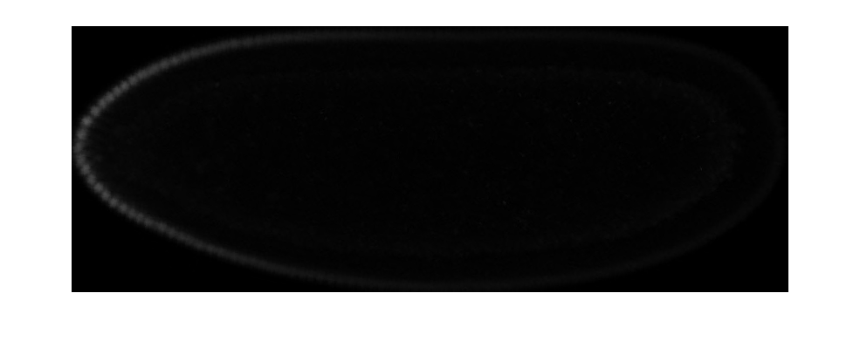
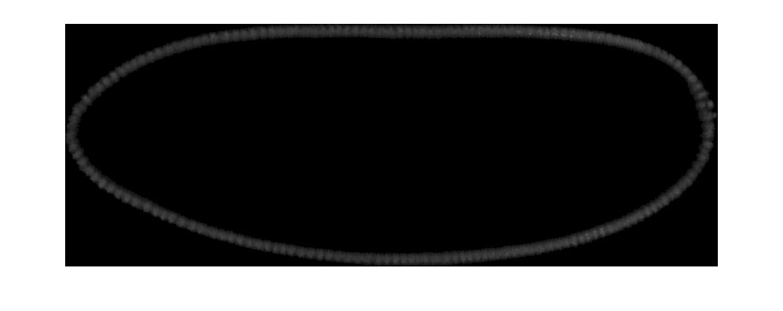
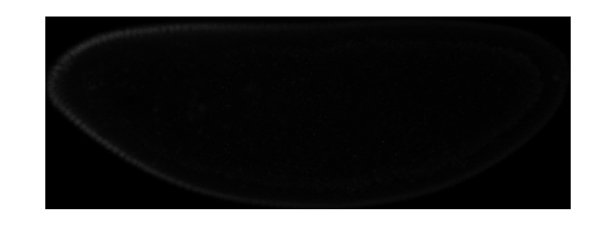
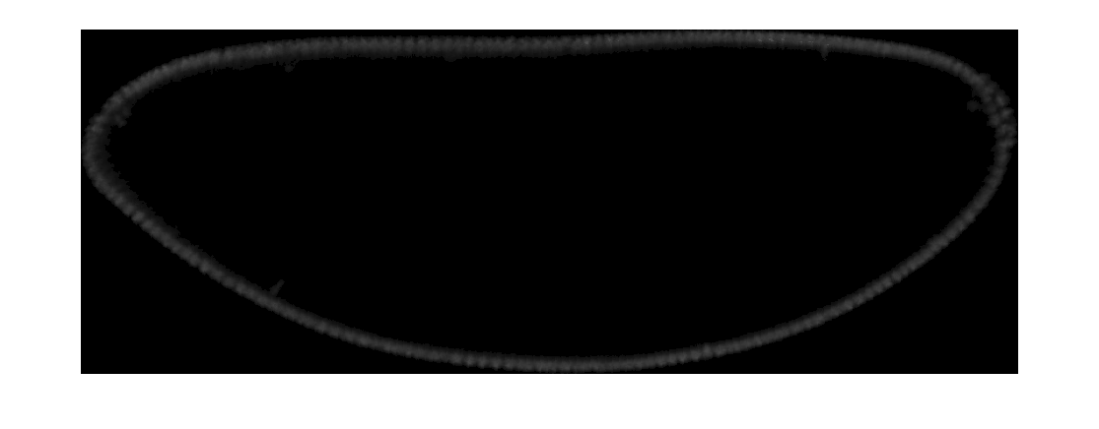
Large and Small embryos immunostained for Bicoid
Bcd protein
DAPI
Line 9.31.2
Line 2.49.3

Slide 2
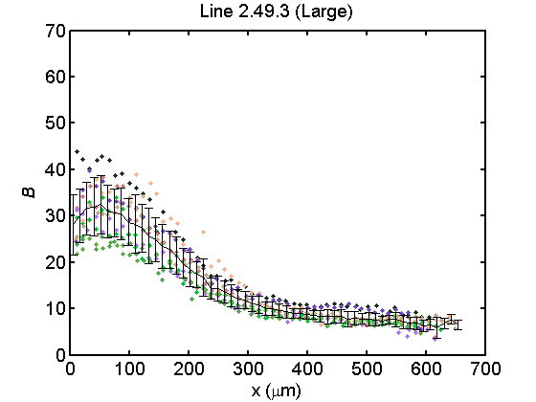
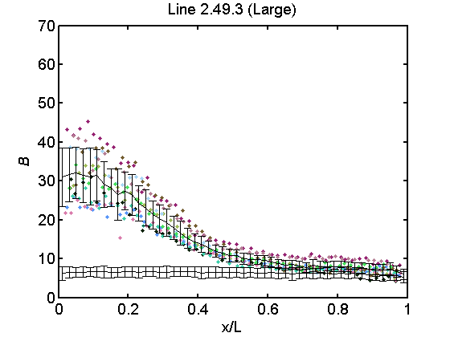
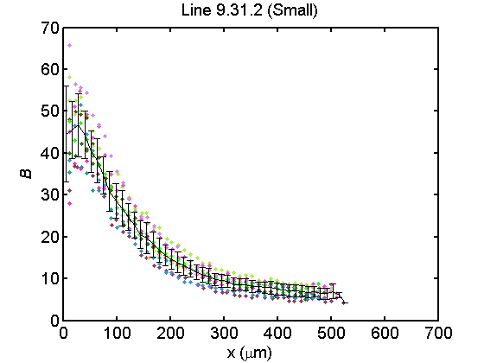
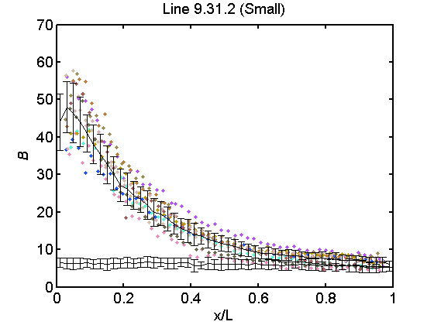
Raw Bcd Profiles

Slide 3
Mean Bicoid profiles show that there is scaling between lines
 | B0 | EL | lambda
Line 9.31.2 | 43.99 | 506.8797 | 103.26
Line 2.49.3 | 31.01 | 626.5723 | 144.4

Slide 4
Lambda plots

Slide 5
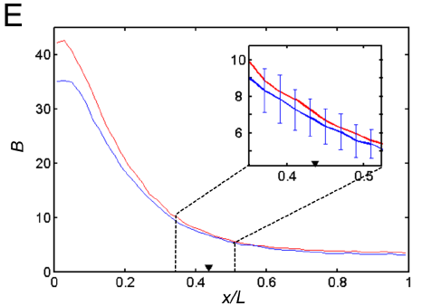
For Line 2.49.3 within-line scaling is lost
He et al. Dev Cell (2008)

Slide 6
Large embryos contain more Bcd protein
 | B
Line 2.49.3 | 513.1685
Line 9.31.2 | 499.4635

Slide 7
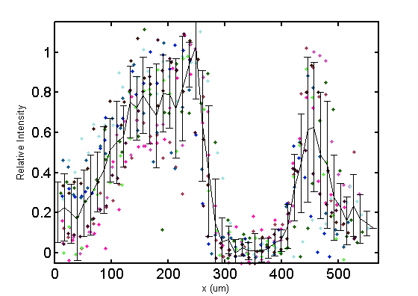
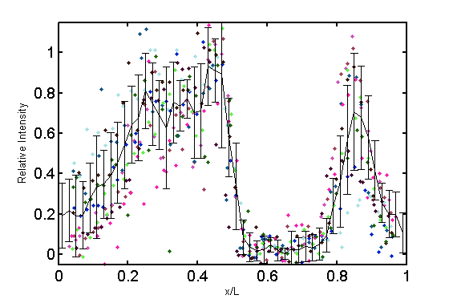
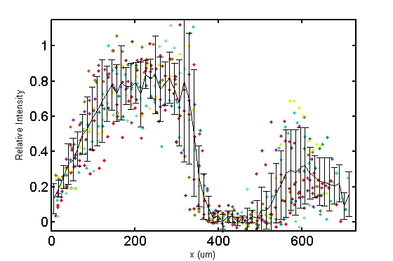
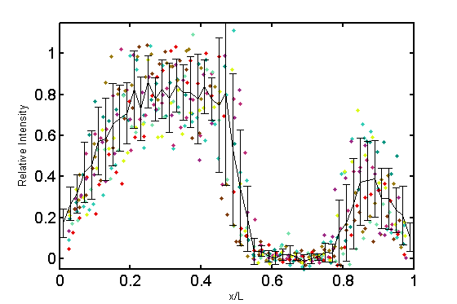
Raw Hunchback in-situ
Line 9.31.2 (Small)
Line 2.49.3 (Large)

Slide 8
Mean Hb profiles reveal scaling

Slide 9
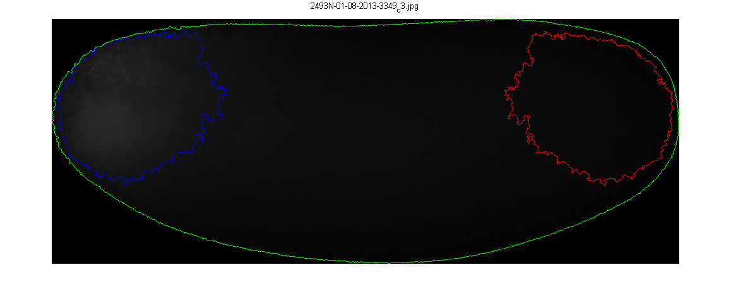
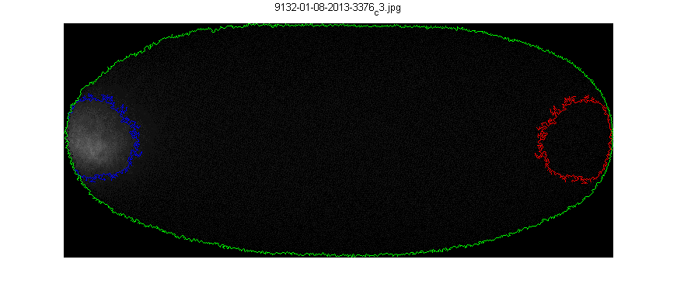
Line 2.49.3 (Large)
Line 9.31.2 (Small)
 | Egg Length (µm) | Intensity (a.u.) | Signal Area (µm²) | Egg Volume (µm³) | Embryo Area (µm²) | n
Line 2.49.3 | 666 ± 41 | 727747 ± 105254 | 26072 ± 8379 | 22141165 ± 3049121 | 315199 ± 30115 | 21
Line 9.31.2 | 498 ± 30 | 370214 ± 102166 | 8537 ± 5792 | 10518025 ± 1323310 | 188945 ± 16875 | 12
p-value | 1.51E-13 | 1.12E-10 | 3.88E-07 | 1.25E-13 | 2.28E-14

Slide 10
Bicoid mRNA aggregate intensity is correlated to embryo size

Slide 11
 | p-value
Line 2.49.3 vs Line 9.31.2 | 3.88E-07
Line 2.46.4 vs Line 9.17.1 | 0.4134
Table X. Bicoid mRNA distribution in Line 2.49.3 embryos is significantly higher than expected. A Student’s T test was performed on the signal area measurements between Lines 2.49.3 and 9.31.2, and Lines 2.46.4 and 9.17.1.
Figure X. Bicoid mRNA is more diffused in Line 2.49.3 embryos. (A) The area of the region bounded by the contour outline of the Bicoid mRNA specific signal was measured and plotted versus egg length for embryos from Line 2.49.3 (Blue) and Line 9.31.2 (Red). (A, inset) A similar comparison of the specific signal area for embryos with an analogous size disparity, Line 2.46.4 (Green) and Line 9.17.1 (Violet).

Slide 12
A
B
C
Fig Y. Bicoid mRNA distribution is dosage independent. (A) The signal area for Bicoid mRNA in was measured in embryos with 1x (blue), 2x (red), and 3x (green) copies of Bicoid. (B, C) The Bicoid mRNA distribution for embryos containing different dosages was plotted against egg length (B) and egg volume (C).

Slide 13
A
B
Fig Z. Bicoid mRNA distribution is generally robust against differences in egg size. (A, B) Specific signal area of cage population embryos stained for Bicoid mRNA plotted against (A) egg length and (B) egg volume.
 | p-value
Cage 1 vs Cage 7 | 0.1053
Cage 1 vs Cage 8 | 0.0869
Cage 1 vs Cage 9 | 0.0117
Cage 2 vs Cage 7 | 0.0077
Cage 2 vs Cage 8 | 0.0069
Cage 2 vs Cage 9 | 3.34E-04
Cage 3 vs Cage 7 | 0.6478
Cage 3 vs Cage 8 | 0.5246
Cage 3 vs Cage 9 | 0.1153
Table Y. Bicoid mRNA distributions across a variety of populations are largely the same. Shown here is a table of p-values from a series of Student’s T-tests applied to different pairings of large and small embryos from different population cages.

